Slide 1
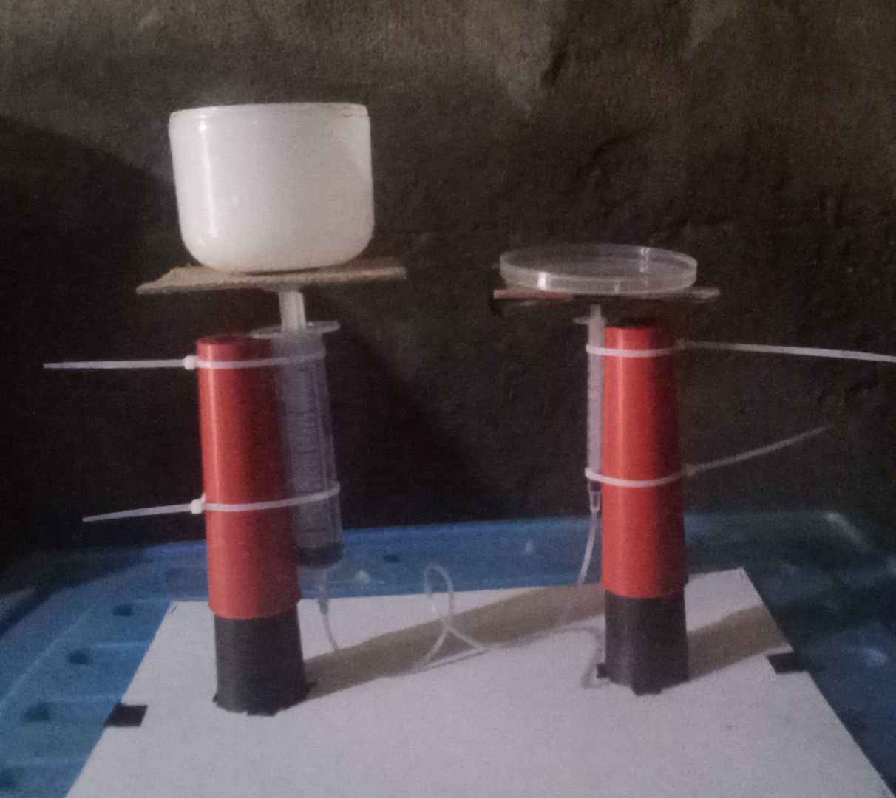
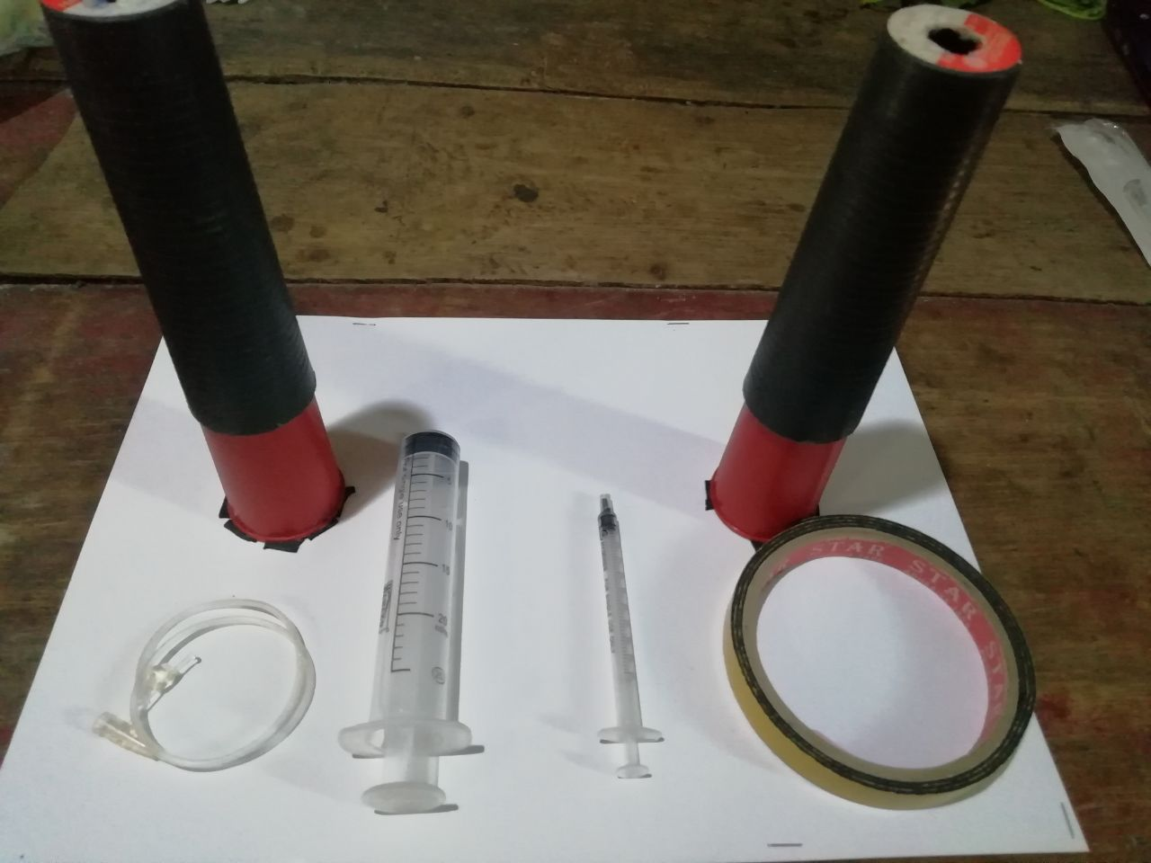
HYDROLIC EXPERIMENT

Slide 2
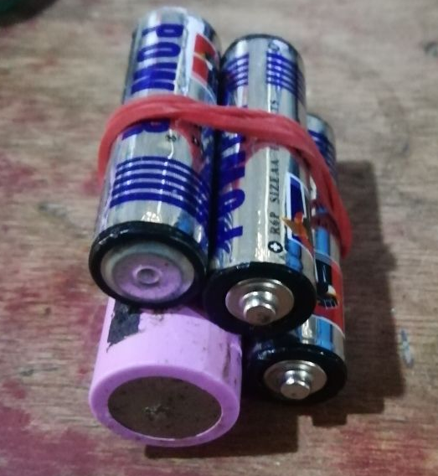
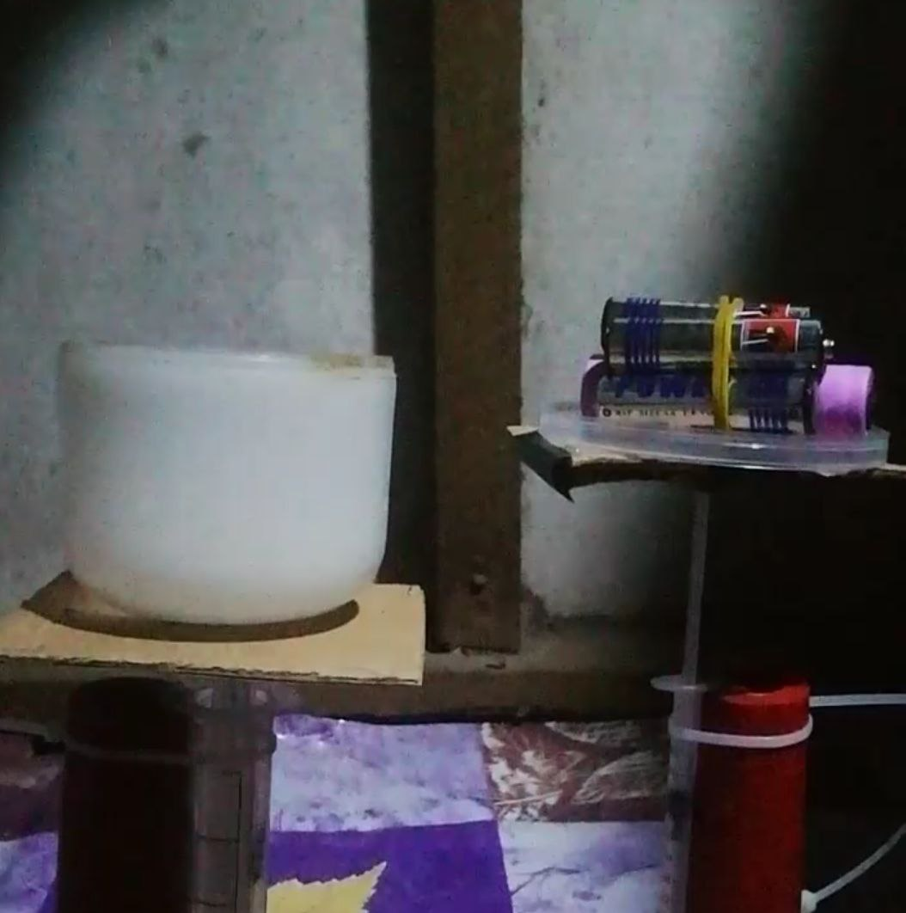
For friction,
You can see this system doesn’t stat to move
Same size and mass
These three small mass and a big mass(3M)
are Friction for this system.
Three small mass=one big mass

Slide 3
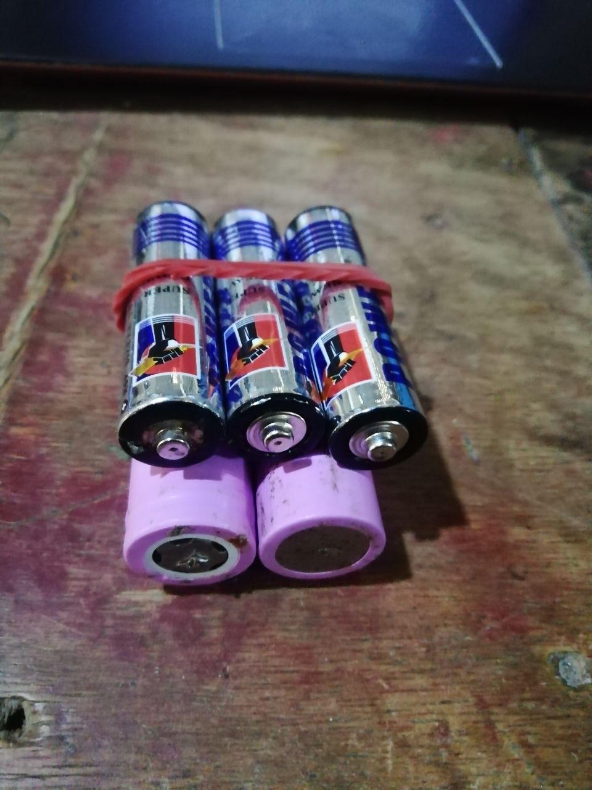
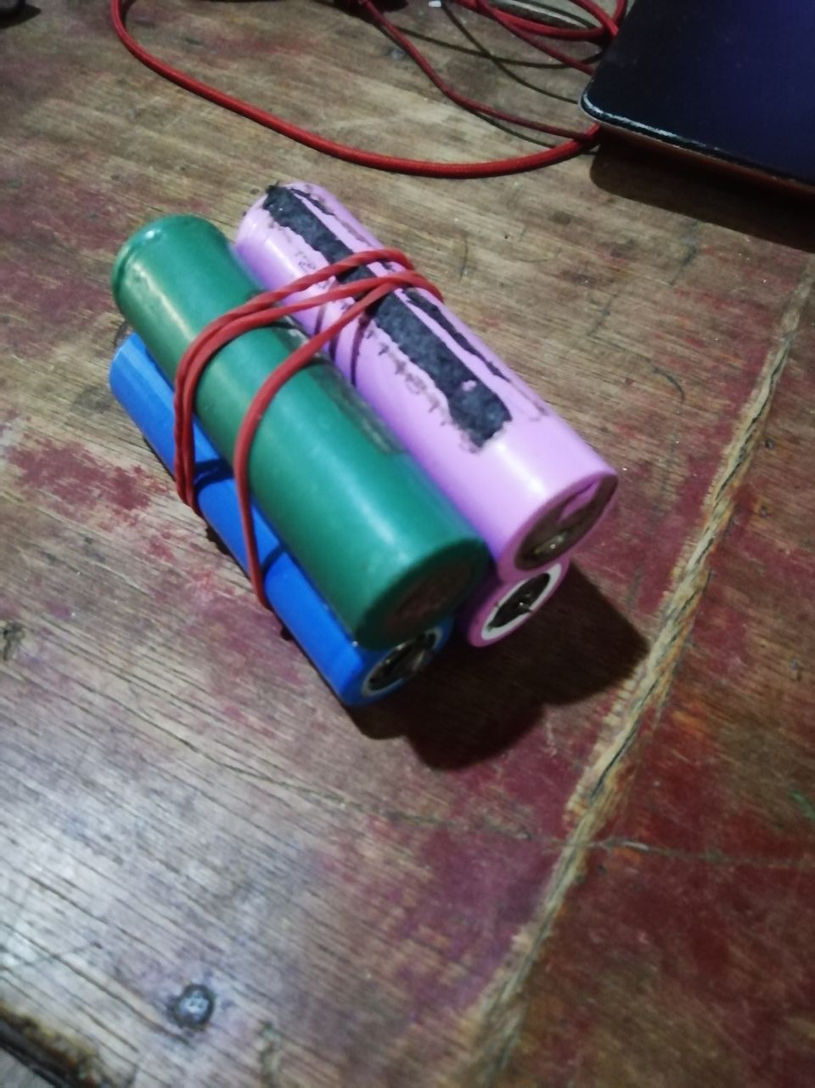
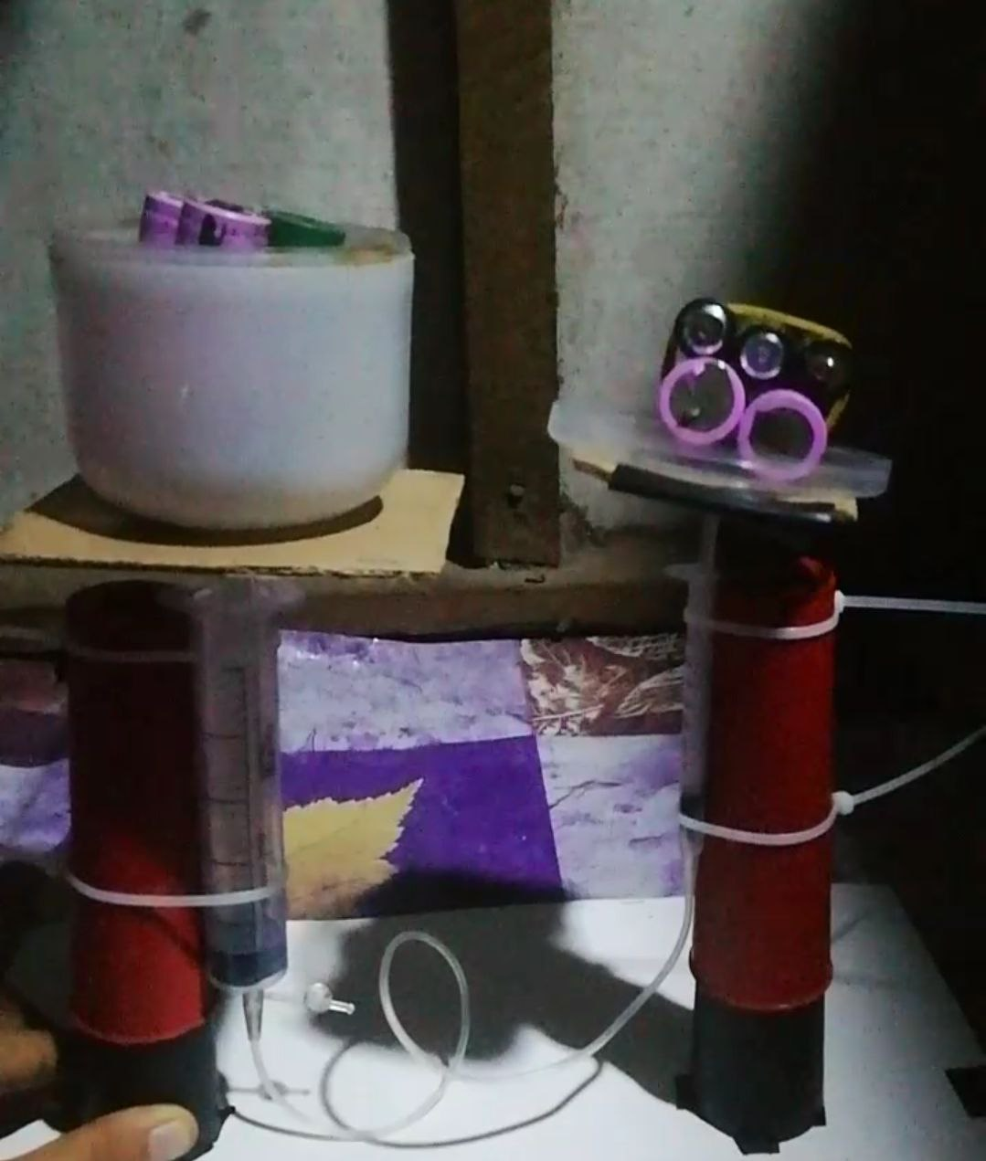
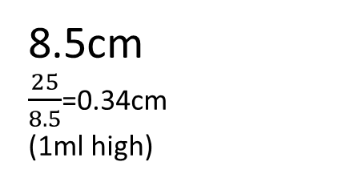
Start to move, lift
Object 1
,
Object 2
These three small mass and
a big mass(3M)
Four mass,=4M
Three small mass=one big mass
8.5cm
$\frac{25}{8.5}$=0.34cm
(1ml high)
5.7cm
(1ml high)
0.3cm lift

Slide 4

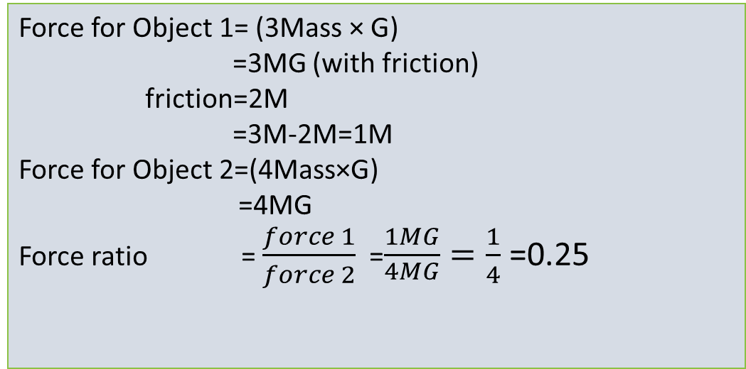
Force
Four mass,=4M
G=gravitational force
These three small mass and
a big mass=(3M)
Force for Object 1= (3Mass × G)
=3MG (with friction)
friction=2M
=3M-2M=1M
Force for Object 2=(4Mass×G)
=4MG
Force ratio = $\frac{force 1}{force 2}$ =$\frac{1MG}{\begin{aligned}4MG \\ \end{aligned}}=\frac{1}{4}$ =0.25
Four mass,=4M
Three small mass=one big mass
Object 2
Object 1
Force ratio = $\frac{1}{4}=$0.25

Slide 5




Area
Area for object 1
object 1
Volume= Area $×Heigh$
1ml = A ×5.7cm
1${cm}^{3}$ =A (5.7cm)
A = $\frac{1{cm}^{3}}{5.7cm}$= 0.175${cm}^{2}$
object 2
8.5cm
0.3cm lift
Area for object 2
Volume= Area $×Heigh$
1${cm}^{3}$ =A (0.3cm)
A =$\frac{25{cm}^{3}}{8.5cm}$= 2.94${cm}^{2}$
$\frac{25}{8.5}$=0.34cm
5.7cm
(1ml high)
(1ml high)
Area ratio= $\frac{0.175}{2.94}=0.059$

Slide 6
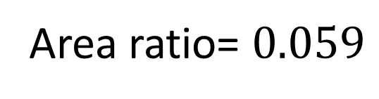
Force ratio = 0.25
Area ratio= $0.059$
According to Pascal's Law,
the force ratio and area ratio should be the same.
The difference between the two ratios can be seen in this system.
That means we can put more mass on Object 2 (the larger one).
But
The force ratio can be larger than the area ratio,
but the area ratio cannot be larger than the force ratio."

Slide 7
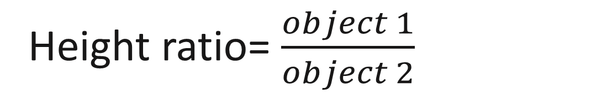

Height
object 1
Object 1’s distance = 5.7cm
Object 2’s distance = 0.3cm
object 2
=$\frac{5.7}{0.3}=19$
Height ratio= $\frac{object 1}{object 2}$
5.7cm
0.3cm
The height ratio is greater than 1,
that is why there is a difference in size between the two cylinders.
The larger one has a maximum volume of 25 ml,
while the other has a maximum volume of only 1 ml."
If you want to get a height ratio of 1, you need to use cylinders of the same size."

Slide 8
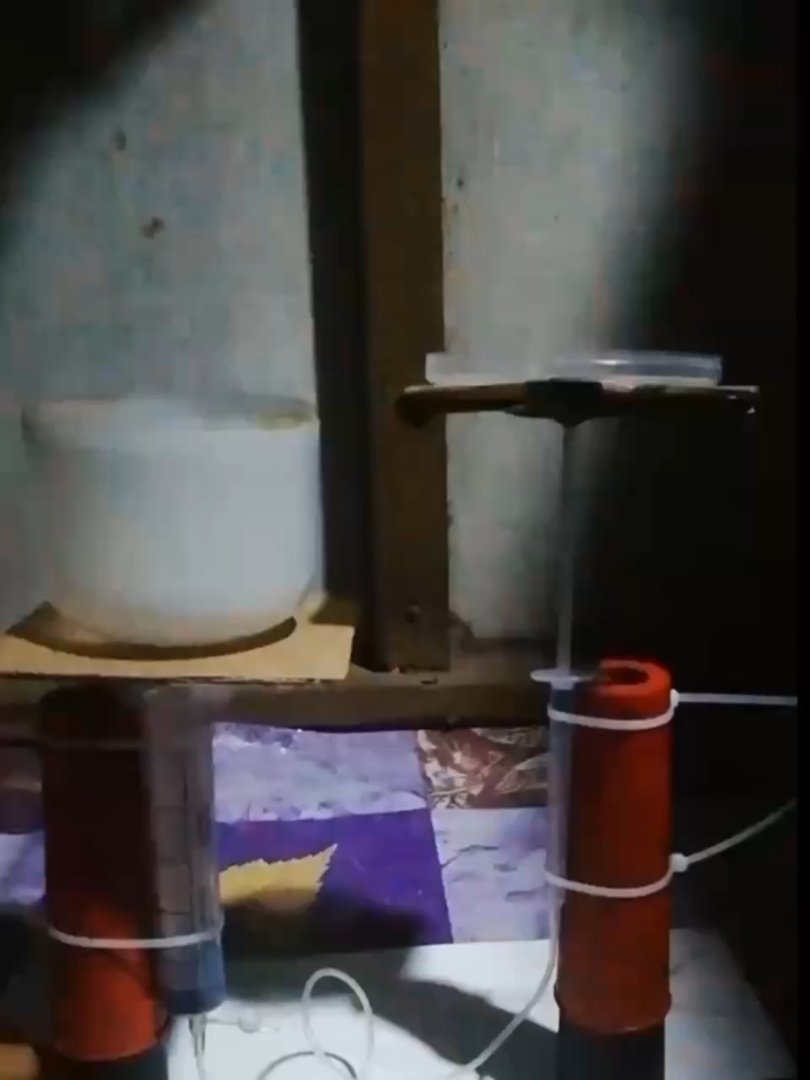
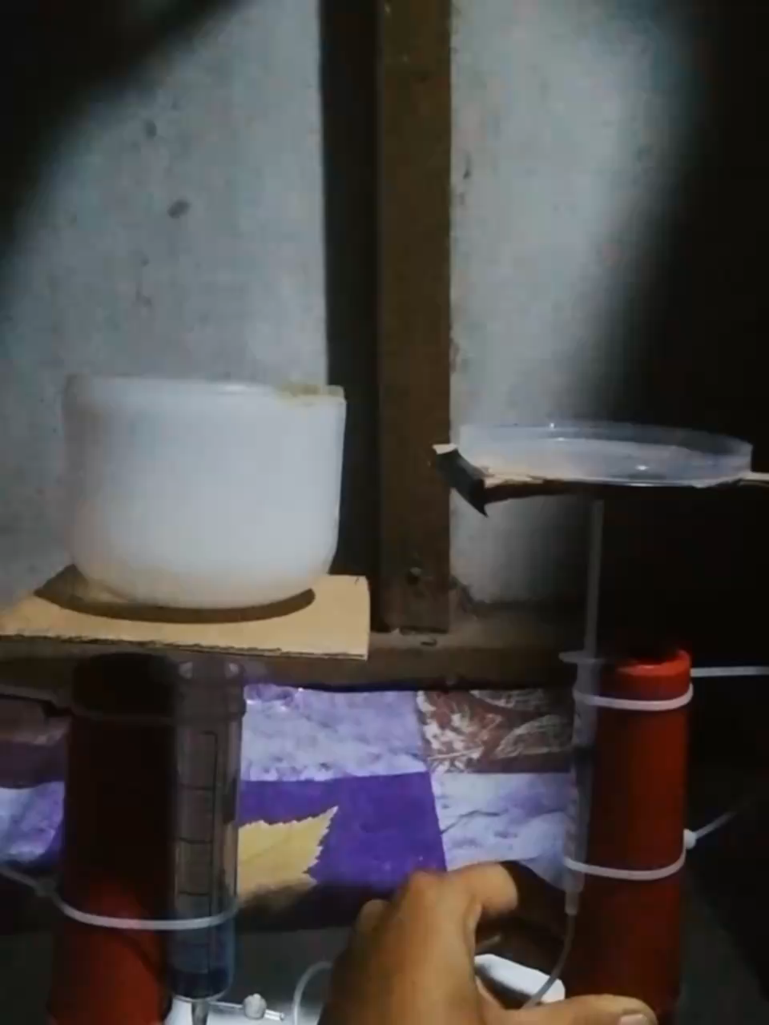
Friction

